Slide 1
Industry Session:
PS 3526 Statement of Ownership, Management and Circulation
for Periodicals
August 2023
Notes:
Hello! Today we are going to be going over the PS 3526 Statement of Ownership forms and data entry through Postal Wizard.

Slide 2
Statement of Ownership
All authorized Periodicals must file a PS 3526 Statement of Ownership annually by October 1st, submitted either electronically or by hard copy.
Submitted to the Known Office of Publication’s (KOP) Origin Entry (OE) office, not to any Additional Entry (AE) offices.
Reminder letters are mailed and emailed by HQ and can also be printed from PostalOne! by the OE.
Each publication’s (OE) performs an annual review of the publication.
*** You must not request to cancel OE Periodical accounts that are inactive in finance unit of the KOP if there are active Additional Entries and publication is currently being published!!! ***
Notes:
All authorized Periodicals must file a PS 3526 Statement of Ownership annually by October 1st, submitted either electronically or by hard copy.
The information provided on Form 3526 must allow the USPS to determine whether the publication continues to meet the standards for Periodicals mailing privileges. This information includes, as applicable, the identity of the editor, managing editor, publishers, and owners; the owning corporation and its stockholders; any further corporations and stockholders that own at least 1% of the stock of a corporation owning the publication; known bondholders, mortgagees, and other security holders; and the extent and nature of the circulation of the publication, including the number of copies distributed, the methods of distribution, and how much of the circulation is paid in whole or in part.
Submitted to the Known Office of Publication’s (KOP) Origin Entry (OE) office, not to any Additional Entry (AE) offices.
Reminder letters are mailed and emailed by HQ and can also be printed from PostalOne! by the OE.
Each publication’s (OE) performs an annual review of the publication.
*** You must not request to cancel OE Periodical accounts that are inactive in finance unit of the KOP if there are active Additional Entries and publication is currently being published!!! ***

Slide 3
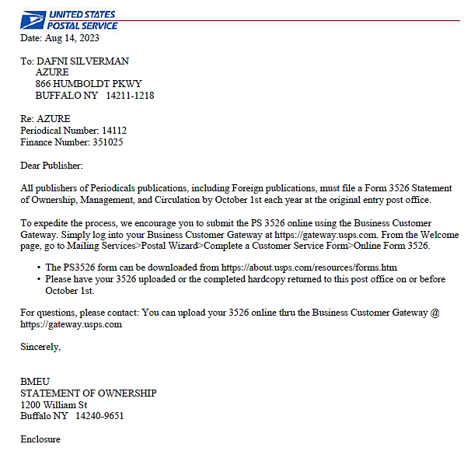
PS 3526 Letter
Notes:
Here is an example of the letter sent as a reminder to the address on file , to submit your PS 3526 for 2023 by October 1st. These letters are sent out each year in August.

Slide 4
Statement of Ownership
The Statement of Ownership must be published in the first issue after submission to the Postal Service (for General and Requester publications)
Customers can submit PS 3526/3526R via the BCG
BCG has step-by-step instructions
Statements of Ownership should NOT be scanned, sent, or submitted to the Mailing & Shipping Solutions Center (MSSC) without prior approval to do so
Any questions or concerns on Statements of Ownership should be directed to your local BMEU Supervisor or Manager
The PCSC may suspend or revoke the Periodicals mailing privileges if a PS 3526 is not filed
Notes:
The Statement of Ownership must be published in the first issue after submission to the Postal Service
(for general or requester, other publications are not required to publish this statement). It must be a complete statement of ownership, containing all information required by the Form 3526, in an issue of the publication to which that SOO relates;. A reproduction of the Form 3526 submitted to the USPS may be used. The required information must appear in an issue whose primary mailed distribution is produced not later than October 10 for publications issued more frequently than weekly, or not later than October 31 for publications issued weekly or less frequently but more frequently than monthly; or in the first issue whose primary mailed distribution is produced after October 1 for all other publications.
Customers can submit PS 3526 or the PS 3526R if Requestor, via the BCG
There are Step by step instructions in “Help” and, in the BCG User Guide .
Statements of Ownership should NOT be scanned, sent, or submitted to the Mailing & Shipping Solutions Center (MSSC) without prior approval to do so.
Any questions or concerns on Statements of Ownership should be directed to your local BMEU Supervisor or Manager.
If a publisher does not comply with the filing or publishing standards and, a notice is sent by Certified Mail from the postmaster. If the publisher further fails to comply within 10 days, the postmaster must notify the Pricing and Classification Service Center (PCSC). The PCSC may suspend or revoke the Periodicals mailing privileges, as appropriate.
.

Slide 5
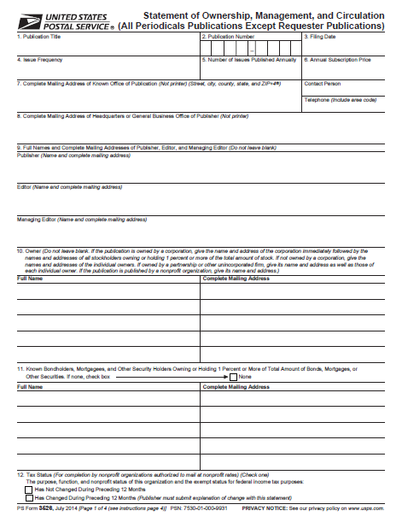
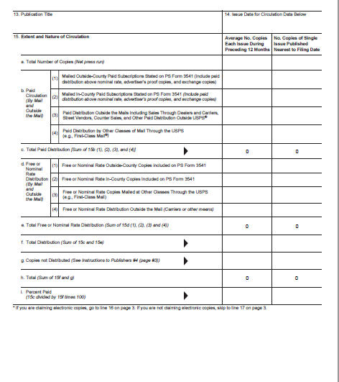
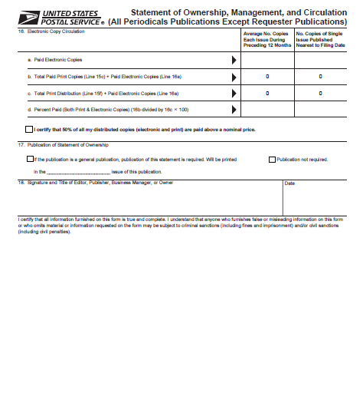
PS 3526
Notes:
This is the PS 3526 form. It is 3 pages, and all applicable sections must be completed . There also is the PS 3526R for requestor publications that has a few minor changes in verbiage. Requestor publications can file the PS 3526 via Postal wizard . For hard copies, you will need to submit to OE post office for them to enter it into PostalOne.
The data from customer entered PS 3526 in PW will carry over to PostalOne for the OE to view, and the OE office to see on their compliance report.

Slide 6
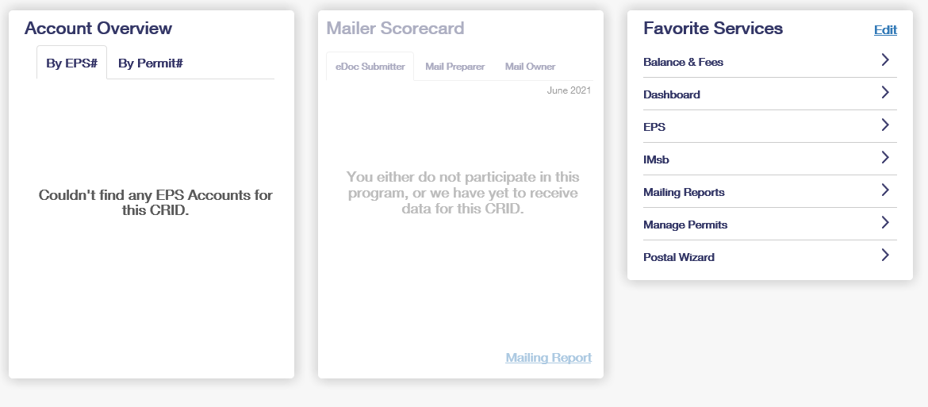
Business Customer Gateway – Online Entry
Notes:
Once logged into your Gateway account, you can locate Postal Wizard by clicking on the Mailing Services tab. You can also save it as a favorite under Favorite Services.

Slide 7
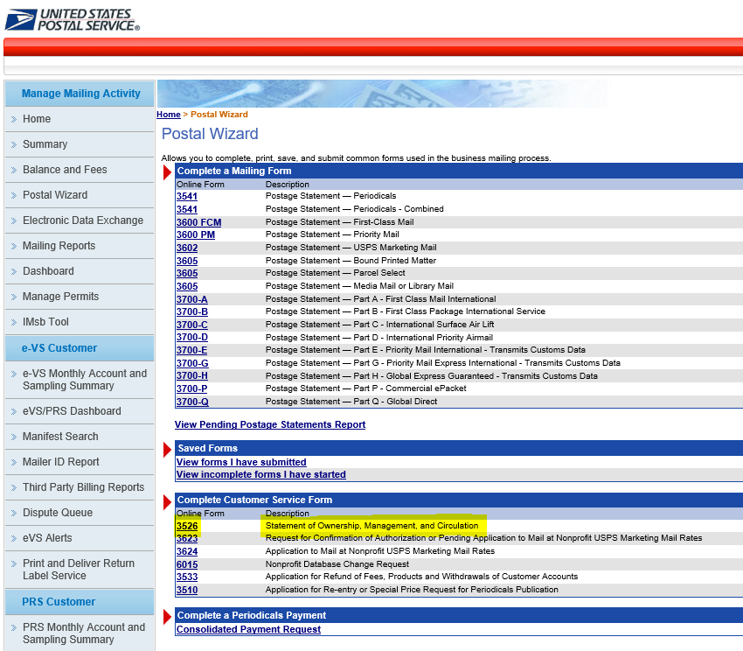
PS 3526 Online
Customers can complete PS 3526
online through
the Business
Customer
Gateway via
Postal Wizard
Notes:
This is the PW section. The PS 3526 is found under Customer forms. In the BCG User Guide there is a help section too. Click PS 3526/3526R .

Slide 8
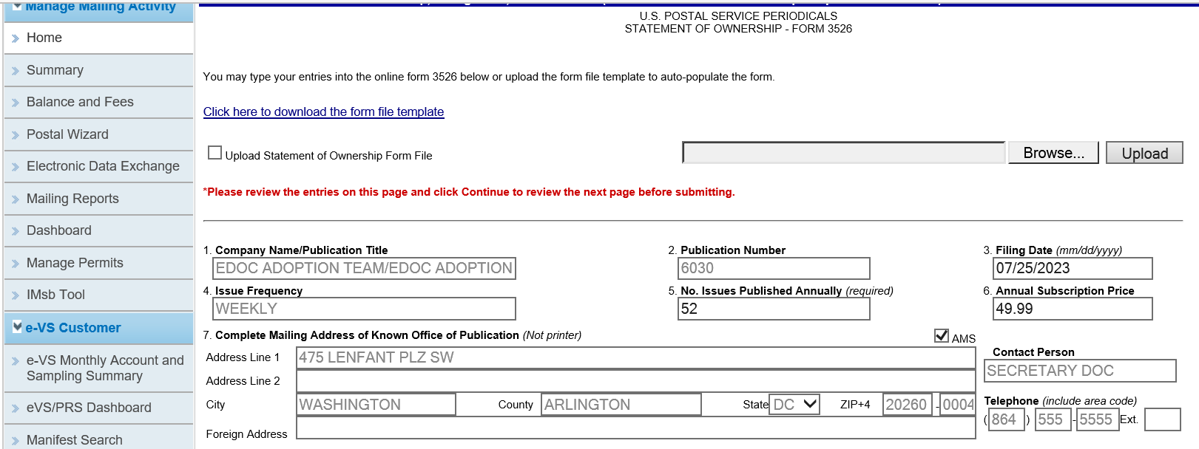
Postal Wizard Entry
Notes:
Eligible PE permits will be listed here. Users must have MMA access to the PE accounts to be able to enter the PS 3526 online. If you do not see the permit needed listed here, you do not have correct access. Contact your BME Supervisor, MBME or the MSSC for assistance.
PW steps :
Users can access the Help menu and select PS 3526 instructions if needed.
The PS 3526 will default to the current calendar year. If you owe a prior year’s PS 3526, make sure to change the year to the correct year.
Select eligible permit. If you have access to OE and AE, make sure to select the OE. Click the correct permit and open the PS 3526. If you’d rather, you can enter the data into an Excel file and upload. I’ll log into the Gateway and do a demo after I show the next few slides.

Slide 9
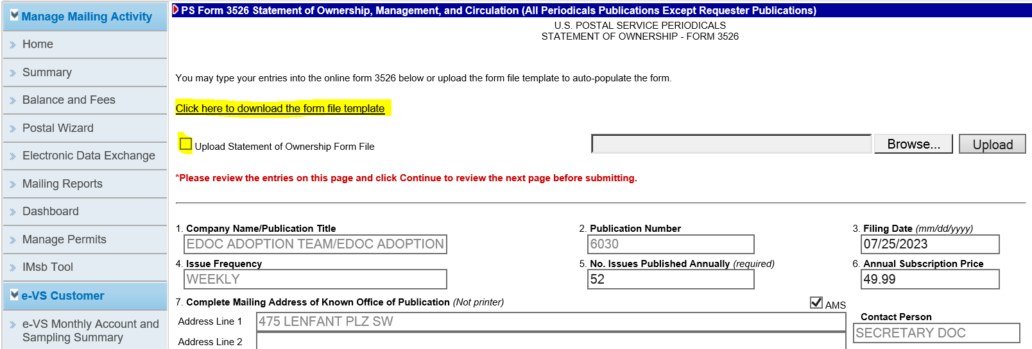
PS 3526
Notes:
As I stated, you can either enter all info in the blanks on the screen or enter into an Excel spreadsheet template. You then upload the completed PS 3526 as an electronic copy.
To enter each line item, use TAB to navigate through entries in the online form to make sure you enter data into all blank fields. Some data is prepopulated and some totals are computed for you.

Slide 10
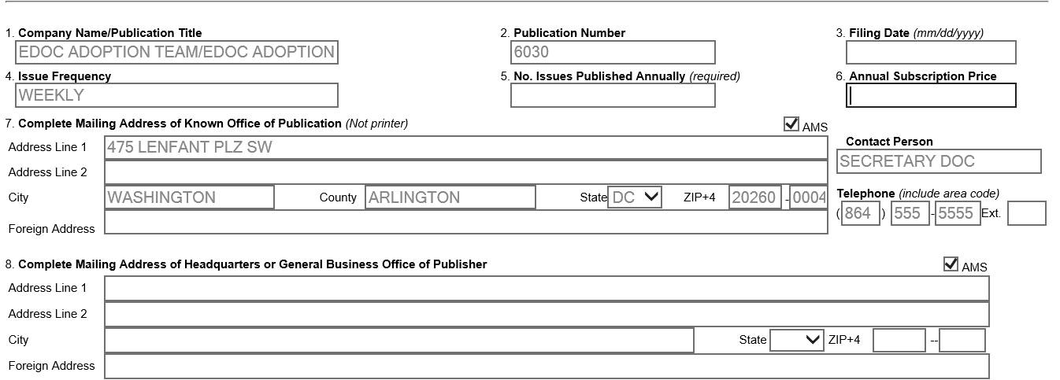
PS 3526
Click the USPS Pub No. or the ISSN Number for the publication. PS Form 3526 opens.
Enter basic publication information and associated individuals (such as the publisher, editor, etc.). The number of issues published per year and Publisher are required.
If Publisher, Editor, and Managing Editor are the same, select the Same as Publisher check box for the Editor and Managing Editor and the PostalOne! system will complete those fields with information from the Publisher fields.
If Editor and Managing Editor are unnecessary, select the N/A check box.
To verify address accuracy, select the AMS check box.
STOP
Notes:
Before entering any information, if the information in grayed sections 1,2,4, & 7 does not match what is current for the publication, STOP! The greyed information is what USPS has on file for this Periodical. If it doesn’t match, a PS 3510 and reentry fee (if applicable) needs to be submitted to the OE office so they can update the account. They will contact the PCSC after receiving the form and fee (if applicable). Note- The address for the KOP cannot be a foreign address or a PO Box or PMB– KOP must be a physical, public address in US. Please make sure you are in compliance with this requirement.
If the greyed sections are accurate, begin to fill in the required data – Enter filing date, number of issues annually, and subscription price. For #8, enter mailing address of HQ or business office, #9 publisher, #10 editor etc. After entering name and address in NO. 9, there are a few short cuts. I’ll show in the demo.
For foreign addresses, only enter information on the Foreign address line. NOTE – should not have PO Box or foreign address for the KOP address section only. Ok for other addresses..

Slide 11
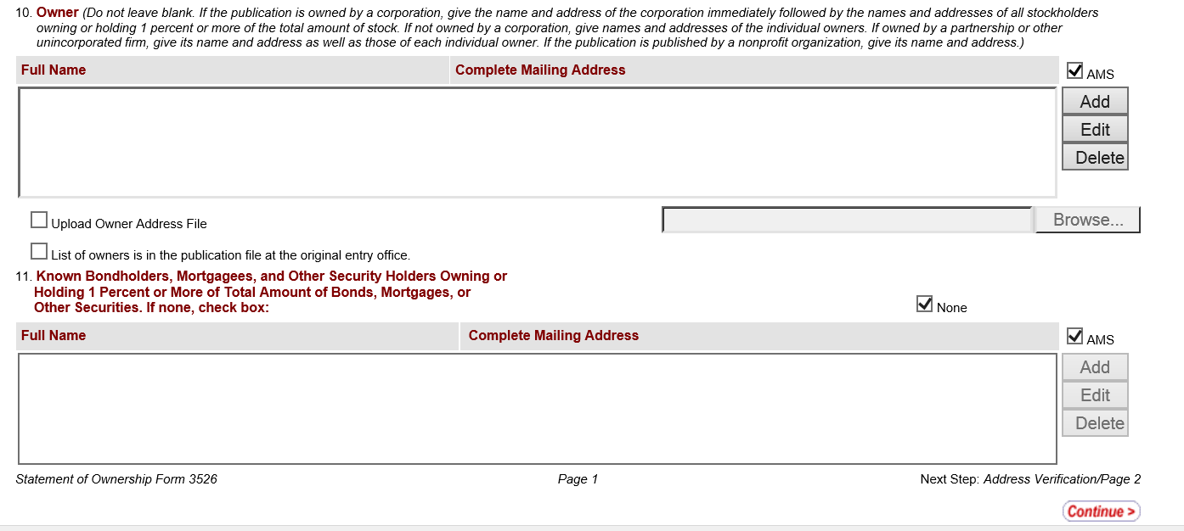
PS 3526
3. Add, edit, or delete owners and known bondholders, mortgagees, and other security holders. List all individuals or organization with more than a 1% interest in the ownership, bonds, mortgages, or securities.
If no individual or organization holds any bonds, mortgages, or securities, select the None check box.
If all owner information is on file at the origin entry office (where the permit was first requested), select the List of owners is in the publication file at the original entry office check box.
To verify the accuracy of addresses, select the AMS check box.
To add an individual or organization, click Add for the appropriate designation (owner, bondholder, etc.). In the dialog box, enter the full name and address of the individual or organization, then click Add. To cancel without saving the new entry, click Close.
To update an individual or organization, click Edit for the appropriate designation (owner, bondholder, etc.). In the dialog box, update the full name and address of the individual or organization, then click OK. To cancel without saving the changes, click Cancel.
To remove an individual or organization, select the appropriate name, then click Delete.
To submit owner information from a file, select the Upload Owner Information check box, then click the Browse. Navigate to the file on your computer, then click the file. Click Open. Owner information cannot be an executable file; it should be either a text file (such as a .txt or .doc file) or a file with an image of the scanned information (such as a .gif or .pdf file).
Notes:
These are the detailed instructions from BCG PW Help for entering the owner’s info in section 10. When entering the Owner information, you will need to click- Add to enter the information. . A pop-up box will open to enter the information for one or multiple names and addresses of owners and then the same for number 11 for the stockholders. If there are no stockholders, you check the box for none. If you have a file for multiple entries, you can attach it. Click, browse and upload.
When done with page 1, click continue in lower right corner. The system will prompt you to approve the AMS address matches.

Slide 12
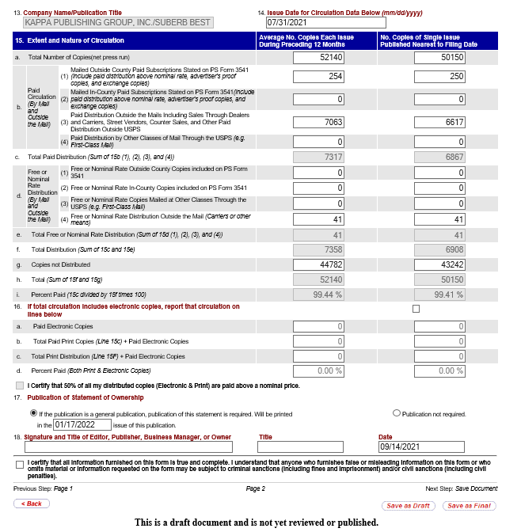
PS 3526
Enter the issue date to use for circulation information. Enter circulation information, tabbing through the fields. All fields need an entry even if it is a 0. The system will automatically compute circulation information into percent paid.
Enter circulation information and the name and title of the mailer approving (signing) the form, then select the certification check box. Signatory name, Issue Date and the certification check box are required.
To save as a draft, click Save as Draft. Otherwise, click Save as Final to submit the form. Drafts save all entered information, but the form is not listed as complete and does not appear as a completed form in USPS reports until a final version has been submitted.
Click OK in the message box to acknowledge that the Statement of Ownership, Management, and Circulation for the current year has been saved.
Notes:
Page 2 - Enter the issue date for the for the circulation information. For monthly publications enter the first of the month for the date of the issue for the circulation data being entered in the righthand column. The data in right column is from the press run of that issue. They left most column is for the average of the year’s issues. The righthand column additional line items is the data from distribution (postage statement or PS 3541 for the issue date in box 14). USPS can compare the PS 3526 to that PS 3541 (pull from dashboard). Section 15 You will need to enter all data as accurately as possible for the paid and unpaid copies, averages in left column, and actual in the right column . Usually, the 2 columns have different values. PostalOne will be computing all greyed boxes. USPS will contact the publisher for any discrepancies. If line 15i in either column on page 2 is 50% or less, an Eligibility review would need to be scheduled immediately. If Percent is between 50 -60%, USPS will send the publisher a Certified Mail letter with Return Receipt letting them know they need to have an eligibility review performed. Greater than 60% does not require a review.
The District Mailing Standards Specialist, Postmaster or a designated employee at the Original Entry Post Office will conduct the eligibility review. Alternatively, the review may be performed by an authorized independent audit bureau.
Enter the information for the month the PS 3526 will be printed (General or requesters) in an issue that the statement relates.. Enter signature , title and date information. Click box to certify . Save as Draft or Save as Final.
I’ll log into BCG and show you an example.

Slide 13
PS 3510
Submitted to the Origin Entry (OE) office when they make changes to their title, frequency, number of issues, NP status or category, or address (PS 3510 is submitted to the new OE for address changes resulting in new OE post office).
$120 re-entry fee for changes except for Nonprofit eligibility and some address changes (no fee if an address change to the KOP does not change the OE post office).
PS 3510M for adding additional entry offices is not required (unless PE is pending or non-PostalOne office). Only need to have the account created in the new finance unit in PostalOne.
Notes:
Oftentimes when entering a PS 3526, you may notice discrepancies and changes that were made without updating USPS records or filing a- PS 3510 filed (Read)
PS 3510 is Filed at the OE office EXCEPT when publisher is changing the Post Office serving publisher’s KOP. Then it is filed at the Post Office serving the publisher’s NEW KOP address. New account needs to be created at the new OE and PS 3526 reassigned. Old KOP account edited to additional or canceled , as applicable.
$120 re-entry fee for changes except for Nonprofit eligibility and some address changes (no fee if an address change to the KOP does not change the OE post office).
PS 3510M for adding additional entry offices is not required (unless PE is pending or non-PostalOne office). Only need to create the account in the new finance unit in PostalOne.
All changes on a PS 3510 will be sent to the PCSC by the local BME, with copy with new ID statement, and cover if a title change. Customers can do multiple actions on one PS 3510 and pay one fee as long as changes take effect within 30 days. PS 3510s can be filed on the BCG, if you have an EPS linked to the PE. Please reach out to your local BME or the MSSC for additional assistance.

Slide 14
PS 3526 Compliance
Filing Form 3526 (DMM 207.8.3.1)The publisher of each Periodicals publication, including foreign publications accepted at Periodicals prices, must file PS Form 3526 by October 1 of each year at the original entry Post Office.
Noncompliance (DMM 207.8.3.4)
If a publisher does not comply with the filing standards in DMM 208.3 by October 1, the Postmaster or the Manager Business Mail Entry of the original entry office must send the publisher notification that they are not in compliance. This notification letter is required to be mailed as Certified Mail with a Return Receipt. USPS will maintain a copy of the letter in the customer’s file.
Notes:
DMM references

Slide 15
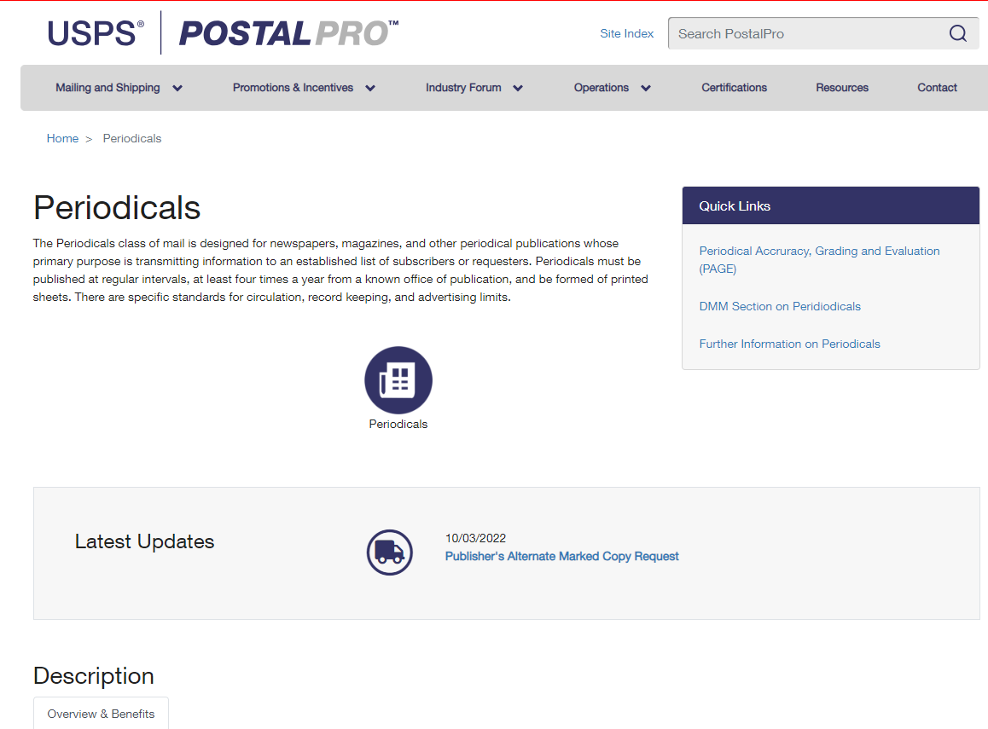
Postal Pro
Periodicals | PostalPro (usps.gov)
Notes:
This presentation and the recording will be posted on PostalPro this week. PostalPro> site Index P for Periodicals

Slide 16
Questions?
QUESTIONS
Notes:
Any questions so far? We will now Go into BCG and PW to enter a PS 3526.

